Slide 1
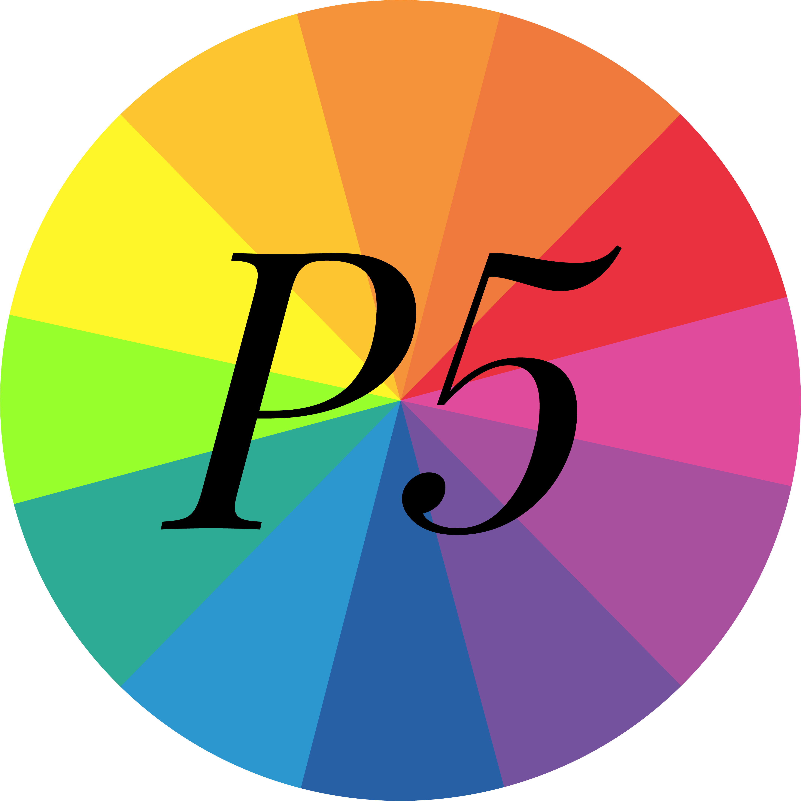

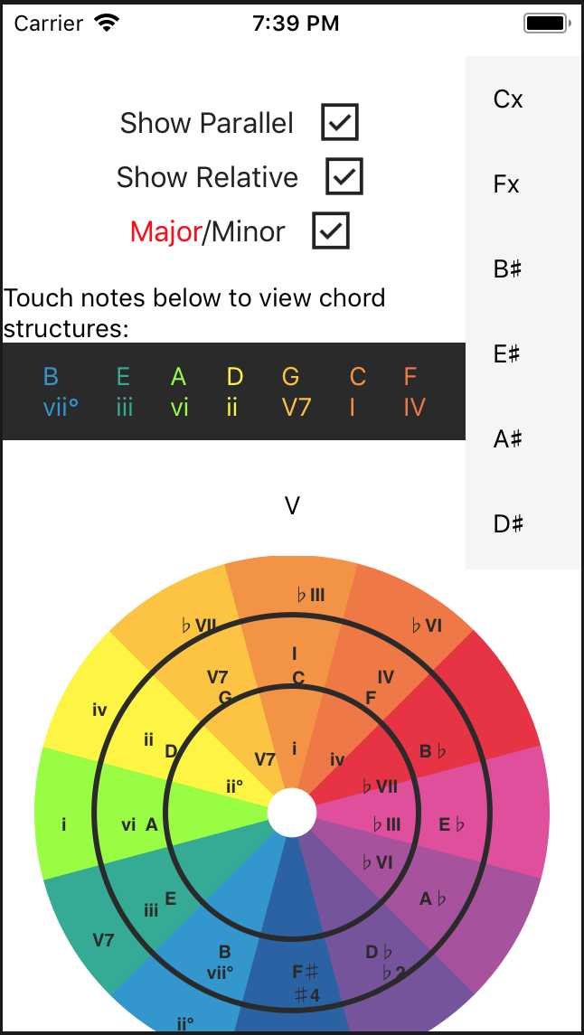
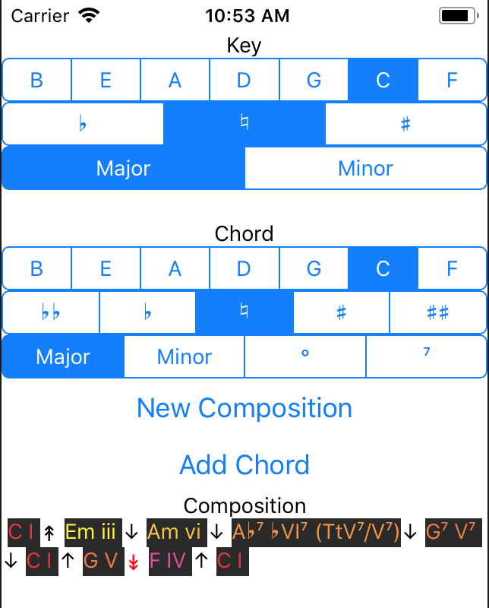
CS45
Tritone: perfect fifth
Creating better musicians by simplifying major music theory topics and presenting the information in a mobile application.
Learn, interact, test
From left to right:
Chris Hebert (Student): hebertch@oregonstate.edu
Aidan O’Malley (Student): omalleya@oreongstate.edu
Lukas Hein (Client, Not Pictured): lukasalihein@gmail.com
The layout of the application we’ve built is split into three pages. Each page intends to address one of the goals of learning, interacting or testing.
The Reference pages, assembled using Lukas Hein’s vast knowledge of music theory, will be where a musician will begin to learn all of the concepts necessary to apply the theory of tonal gravity to their compositions.
A musician can then interact with the app with their new found knowledge by going to the Circle of Fifths page. Here a musician is able to view specific scales and the chords that these scales are composed of. By toggling the parallel and relative keys on and off, the musician can visualize how transitioning between keys is possible and can test out their knowledge using the simple interface and an instrument of their choice.
Once the musician feels confident with the concept of tonal gravity after interacting with the Circle of Fifths, they can test how well they are following the rules that Lukas laid out in the Reference pages by navigating to the Composition page.
React Native
React Native allowed us to create cross-platform (Android, iOS) apps, without needing to write the same app in two languages, for two operating systems.
React Native enabled immediate deployment to the iPhone, allowing us to see what the app would look and feel like on the actual device.
The framework enabled real-time iterative development and debugging, allowing us to make changes to designs and styles based on client feedback during our meetings.
Non-mandatory JSX HTML-like domain language, enabled Aidan to code in a language that he was more comfortable with, while Chris was able to continue working with plain JavaScript functions.
Since React Native uses JavaScript, testing algorithms with a web-browser provided fast feedback.
Because React Native is a JavaScript framework, we were able to pull in open source GUI widgets via NPM (Node Package Manager).
Main Musical Concepts
Tonal Gravity orders the notes of a major or minor scale in intervals of descending fifths. E.g. ‘BEADGCF’ for the C Major scale.
Chord progressions feel as if they are descending toward resolution at the root when they follow this pattern.
A chord is a pair of intervals related to a root tone of a scale: a third and a fifth. E.g. Taking the root, third, and fifth (‘C-E-G’) from the C major scale forms a C Major chord.
The parallel key of a major key is it’s minor key, and vice versa.
Relative Major/Minor keys share the same scale tones but uses the qualities of its respective keys.
Chord Substitutes allow different chords which perform the same function to be substituted for chords in a progression. E.g. Borrowed chords, secondary dominants, tritone, and diatonic substitutions.
The Problem
We believe the current manner in which the grammar of music theory is traditionally taught is inaccessible to new composers due to most existing resources being directed at musicians who have already developed some expertise.
Lukas Hein, our client, had an idea for an app that aims to bridge the gap between new composers and accomplished musicians by providing beginners with an interactive circle of fifths. It provides simple, straightforward explanations of what this circle is, how it relates to Western music, and how new composers can use it. The app allows musicians to apply their new knowledge to compose their own music using this circle, and receive instant feedback on their music.

